Slide 1
A modularized library for motion planning of robots
Chew Keng Siong @Morgan (18b9062)
Under the Supervision of Dr. Ajaz Ahmad Bhat

Slide 2
Tools
01
02
03
04
Webots
Miniconda3
Used for testing and development
Creates the environment for project development
Python
Github
The primary language used in the project
Stores and version controls the project.

Slide 3
Other Tools
05
06
07
IKPY Library
Robotics Toolbox
Has functions that help in understanding IK
Also provides variety of useful functions
URDF2Webots
Used to convert URDF files for use in Webots

Slide 4
Goals
These are the main overall objectives of the project
Create an iCub robot inside the Webots Environment. | Then create functions for it that allow it to extend and move the joints to reach and touch an object.
Create a PMP class/library | This library offers, a PMP for any body chain, and with multiple parallel goals [Inverse kinematics] Allows control for desired pose x, velocity x_dot, configuration q, joint velocities, q_dot, force, joint torques, Allows this for any robot given forward Kinematics (fK), Jacobian J, Stiffness K, Admittance A)
Create a push request | The final objective is to add this class to the Ikpy library python In Summary, the project aims to contribute and add to the existing IKPY library.

Slide 5
Why?
Simplified development
Increased flexibility
Save time and effort in creating new software tools for robotic systems.
Make it easier to apply inverse kinematics to different types of robots.
More control options
Desired pose, velocity, configuration, joint velocities, forces, and joint torques

Slide 6
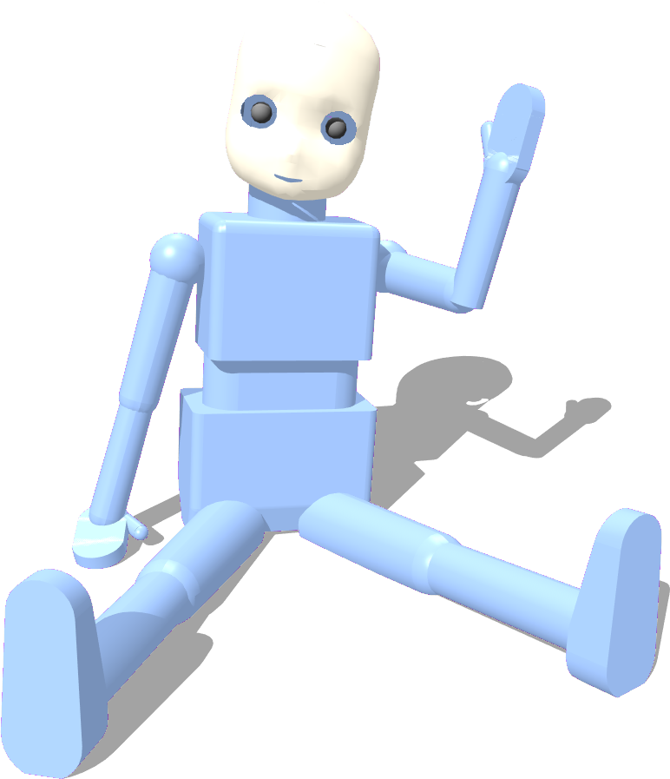
iCub
Joints
As stated in the Webots User Guide, the robot has 53 motors that move the head, arms & hands, waist, and legs. These motors each represent joints, in terms of Webots.
A joint allows two bodies to connect and move in relation to one another, with properties such as limits of motion, torque and velocity being able to be configured.
The benefit of using an iCub robot model is the amount of joints it possesses
About
The robot chosen for this project is the iCub robot developed at IIT as part of the EU project RobotCub. The model of iCub specifically used in this project at the moment, is the standing iCub created for the Webots sample world icub_stand.wbt.

Slide 7
Phases of First Goal
1
2
3
Understand the core concepts
Create objects needed for hand reaching task
Create a basic move function that takes in configurable input and moves the joints of a limb accordingly,
Import IKPY functions and move the joints of a limb according to the calculation results of these functions

Slide 8
01
The task
Given an object, the robot should be able to reach by moving the joints accordingly

Slide 9
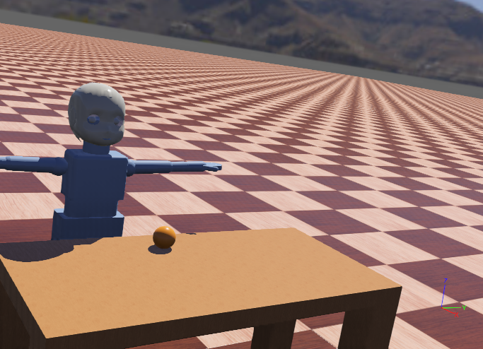
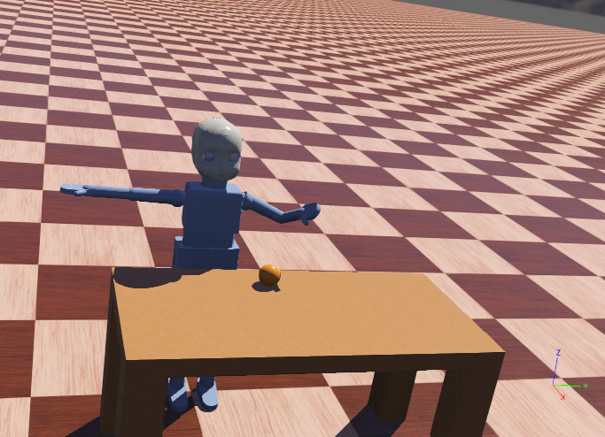
Create functions for it that allow it to extend and move the joints to reach and touch an object.
The Goal
The Stage
The robot should reach the target.
An Object is placed in front.

Slide 10
02
Proto
An early controller made for basic movement

Slide 11
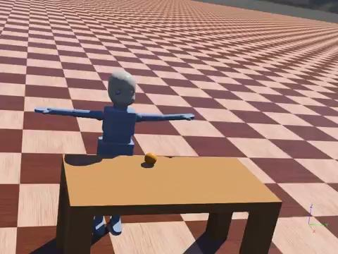
The Proto Move Function
This function uses the body parts of the iCub model as arguments and moves the body parts (Such as the Left arm, torso or right leg) that were passed to the function. With the position and velocity of the individual joints of the body parts called by the function being set according to the config specified in the function arguments.

Slide 12
02
IKPY
After Importing functions for the hand reaching tasks.

Slide 13
Inverse Kinematics
the most important concept being implemented in the Project. To explain briefly, it refers to the computation of the joint angles that are needed to move a limb (in the case of this project) to reach the desired end-effector position (Target). Using the results of these calculations to set new positions and rotate the joints to angles that bring the limb to the target. This method is commonly done using a jacobian matrix.
UBD

Slide 14
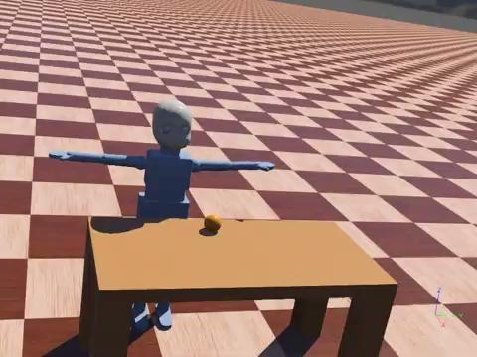
Implementing IKPY
inverse_kinematics() method is called from the IKPY library, to determine the joint angles needed for a body part of the robot to reach a desired end effector position (The ball in this task).

Slide 15
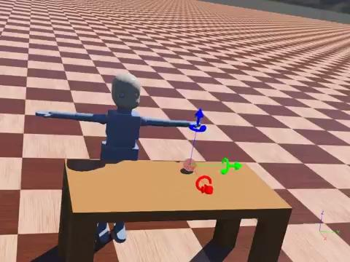
Implementing IKPY Part 2
When the target (Ball) is moved (in this case slightly to the left of the robot. The robot should be able to at least attempt to reach it.

Slide 16
Summary
The implementation and testing of the PMP class has not been conducted at this stage of the project. Important concepts such as Inverse Kinematics and libraries such as IKPY and Roboticstoolbox have been researched and tested during the first semester of this project. Which are needed to finalize the goals of the project.
UBD

Slide 17
Progress
Here
Testing
Familirazied with IKPY
Outlined PMP Class
Begin testing the PMP class on other robot models.
1st
Semester
Summer
2nd Semester
November
Class Implementation
Push
Begin implement the PMP class designed in the 1st Semester.
Finalize the class and make a push request.

Slide 18
References
Bhat, A. A., Akkaladevi, S. C., Mohan, V., Eitzinger, C., & Morasso, P. (2016). Towards a learnt neural body schema for dexterous coordination of action in humanoid and Industrial Robots. Autonomous Robots, 41(4), 945-966. doi:10.1007/s10514-016-9563-3
Corke, P. (1996). A robotics toolbox for MATLAB. IEEE Robotics & Automation Magazine, 3(1), 24-32. doi:10.1109/100.486658

Slide 19
18b9062 @ubd.edu.bn
The End

